Slide 1
SCT 2023
Business Session

Slide 2
Approval of
2022 Business Meeting
Minutes

Slide 3
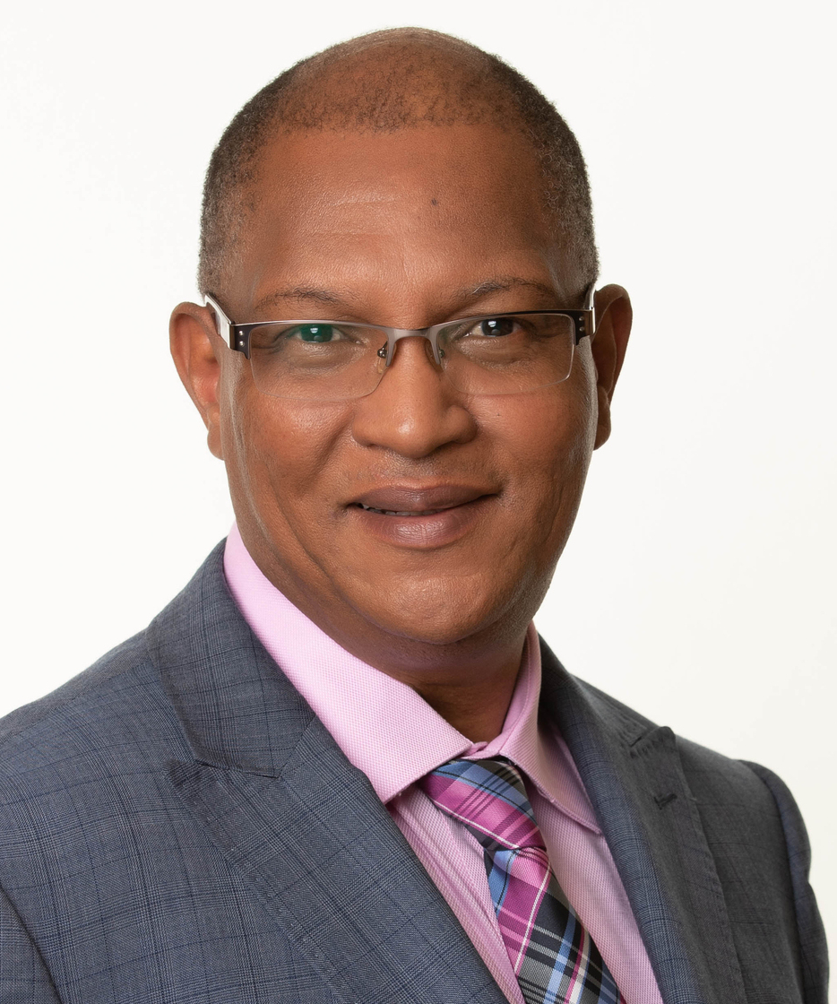
SCT President
2022 - 2023
Lehana Thabane

Slide 4
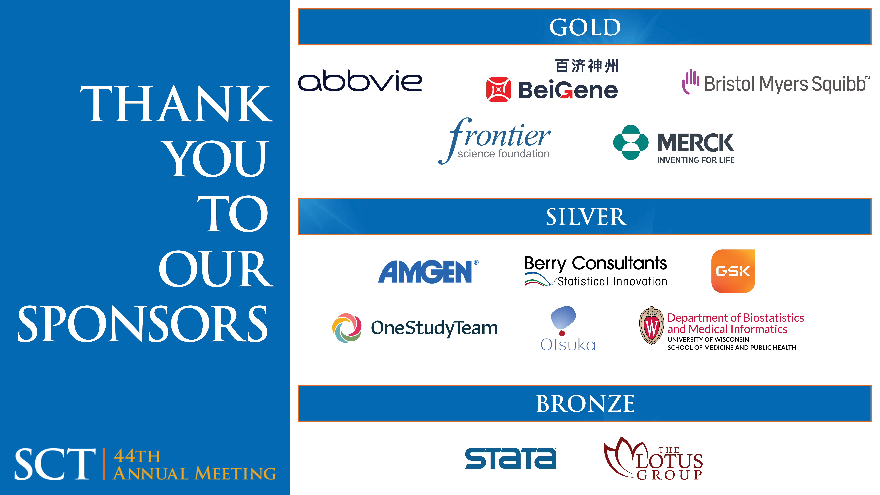

Slide 5
CITI Program, a division of BRANY
EvidentIQ
Genemarkers
OneStudyTeam
Rho
StataCorp
Zeto, Inc.

Slide 6
Year-in-Review

Slide 7
Establishment of the Advisory Role
To maintain institutional memory for the Society
To provide orientation to all new committee members, Board and EC members
To update all SCT documents
Domenic Reda was the first person to hold the role

Slide 8
Changes and New Initiatives for This Year
Provided orientation and work-plans for all committees, EC and Board
Updated key documents
Reduced frequency of Board meetings
Board approved mechanism to diversify the Board

Slide 9
Changes and New Initiatives for This Year
Board approved the Strategic Plan Oversight Task Force
Introduced regular risk assessment for SCT
Introduced evaluation of Board meetings
Acknowledgement of long-term membership and service for SCT members

Slide 10
2023 – 2026 Strategic Plan
Summary

Slide 11
Refresh of the Strategic Plan
Established a Strategic Plan Committee to refresh the 2018 Strategic Plan led by Mithat Gönen
Refreshed strategic plan is complete – this includes three goals:
  Diversify membership by proactively recruiting members of various affiliations/sectors, geographical locations, ethnic/racial categories, genders and professional or disciplinary backgrounds;
  Nurture Society leadership and strive to include international representation in leadership; and
  Enhance the financial health and sustainability of the Society

Slide 12
Things for Future Consideration
More concerted effort for fund-raising campaign
Close monitoring of risks
Close monitoring of the Strategic Plan implementation and progress

Slide 13
Recognition of
Program Committee Chair
&
Education Committee Chair

Slide 14
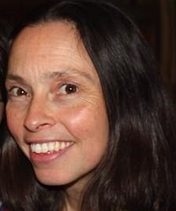
Program Committee Chair
Karla Hemming, PhD

Slide 15
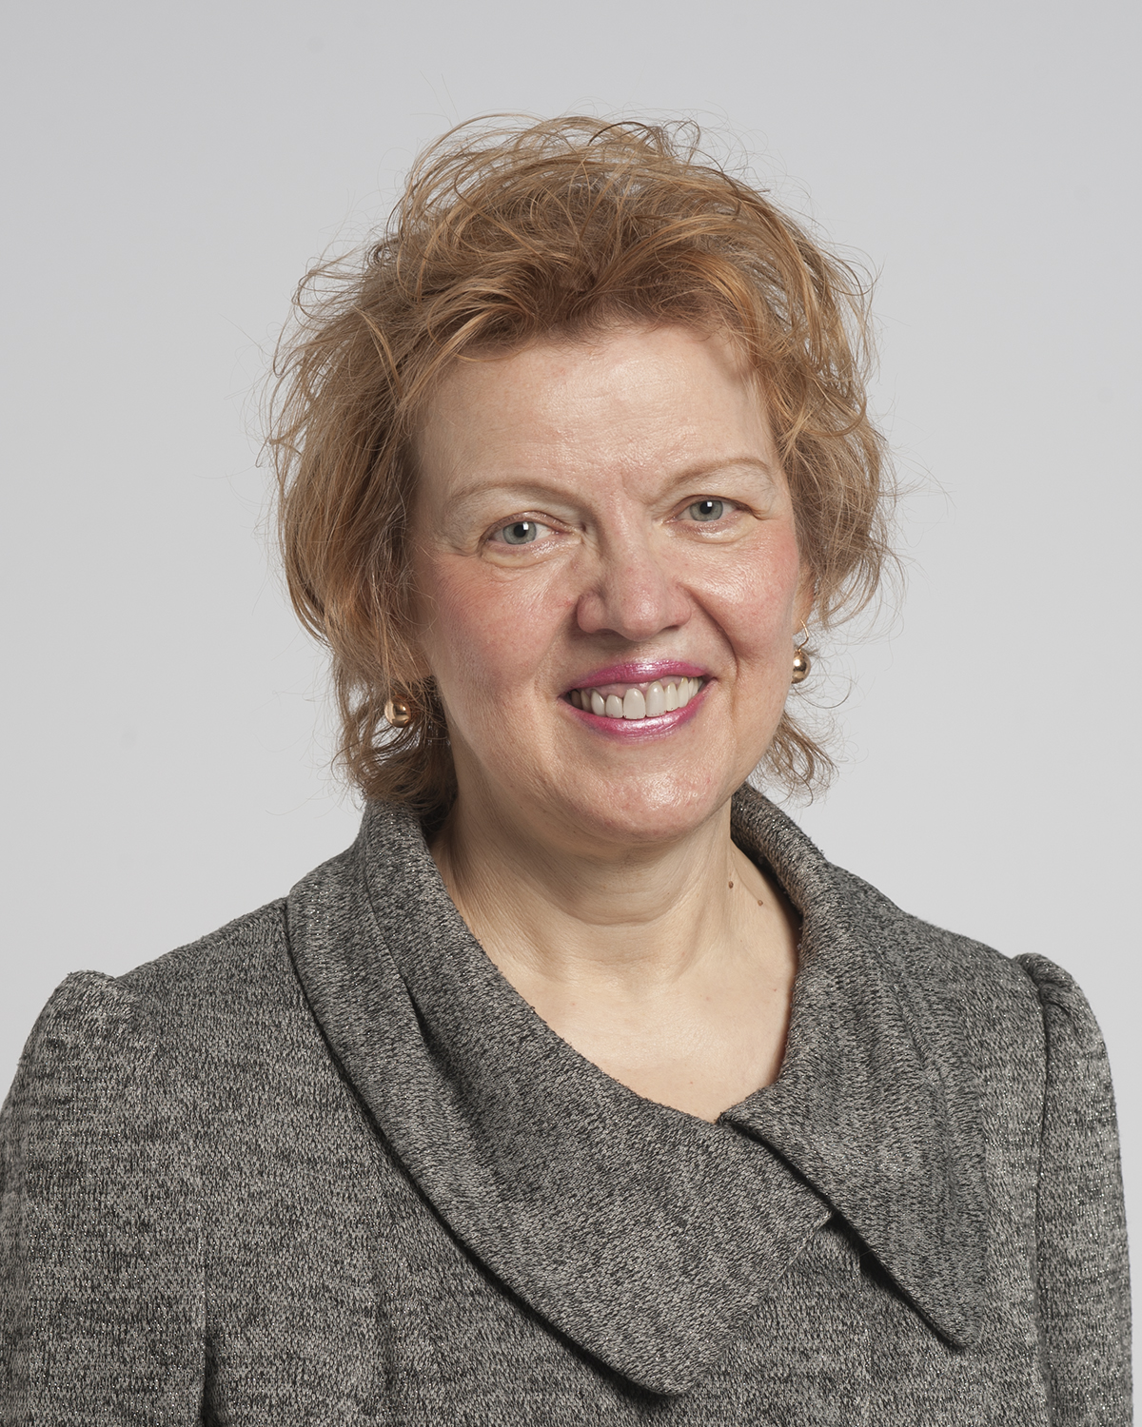
Education Committee Chair
Larisa Tereshchenko, MD, PhD

Slide 16
Recognitions
Thank you to the Program and Education Committees and all Committees for their work to prepare us for the Annual Meeting
Thank you to the EC and Board members
Thank you to EAI management company for their support of the SCT functions and operations
Thank you to all members for attending the meeting

Slide 17
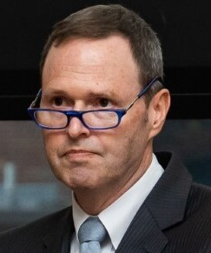
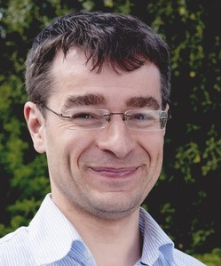
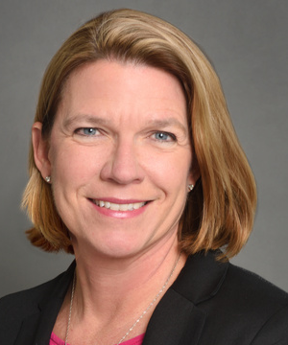
Election Results
President-Elect
Scott Evans
George Washington University
Incoming Board Member
Jonathan A. Cook
University of Oxford, UK
Incoming Board Member
Elizabeth Garrett-Mayer
American Society of Clinical Oncology

Slide 18
Congratulations
Welcome and congratulations to Dixie Ecklund into the SCT President role and Scott Evans into the SCT President-elect role
Congratulations to all new Board Members, new Committee Chairs/Co-Chairs and new committee members

Slide 19
Thank You
Thank you to all of you for trusting me to be your President
  It has been a great privilege to work with all of you
  It has been an opportunity for growth and reflection
  I hope I made you proud
  I thank you for your individual and collective support

Slide 20
Financial Report

Slide 21
2022 Year-End Financials
Total Revenue: $513,678 (Budgeted $601,125)
Total Expenses: $613,373 (Budgeted $598,300)
Net Loss: ($99,694) (vs. budgeted gain of $2,825)
Total Net Assets on 12/31/2022: $173,467

Slide 22
SCT Logo Slide

Slide 23
Clinical Trials Journal
Report

Slide 24
SCT Logo Slide

Slide 25
Membership Committee
Update

Slide 26
Membership Report
2022 | January | February | March | April | May | June | July | August | September | October | November | December
Full Member | 691 | 701 | 758 | 785 | 938 | 681 | 685 | 689 | 695 | 699 | 703 | 709
Student | 27 | 28 | 39 | 47 | 75 | 61 | 61 | 61 | 61 | 61 | 63 | 63
Post Graduate | 11 | 10 | 14 | 14 | 14 | 6 | 6 | 6 | 6 | 6 | 6 | 7
Emeritus | 24 | 25 | 26 | 26 | 26 | 22 | 22 | 22 | 22 | 22 | 22 | 23
TOTAL | 753 | 764 | 837 | 872 | 1053 | 770 | 774 | 778 | 784 | 788 | 794 | 802
2023 | January | February | March | April | May | June | July | August | September | October | November | December
Full Member | 712 | 406 | 476 | 491
Student | 70 | 31 | 43 | 46
Post Graduate | 6 | 4 | 6 | 6
Emeritus | 23 | 20 | 21 | 22
TOTAL | 811 | 461 | 546 | 565

Slide 27
Encourage Colleagues to Join Us!
The Society for Clinical Trials (SCT) includes professionals with diverse backgrounds and offers benefits that aid in the development of careers in clinical trials, including:
Networking opportunities
Continuing education opportunities such as webinars and a subscription to Clinical Trials Journal
Substantially discounted registration fees to SCT Annual Meetings
Professional development, leadership and presentation opportunities
Societal outreach and communications

Slide 28

Membership Committee Members
Chair: Dikla (Dee) Blumberg
Co-Chair: Julie Qidwai
Members:
  Karla Ballman
  Emine Bayman
  Jonathan Beall
  Janel Fedler
  Brenda Kurland
  Cristina Murray-Krezan
  Charles Weijer

Slide 29
SCT Logo Slide

Slide 30
Communications Committee
Update

Slide 31
SCT Logo Slide

Slide 32
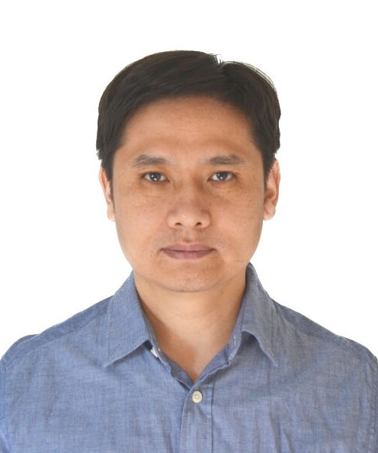
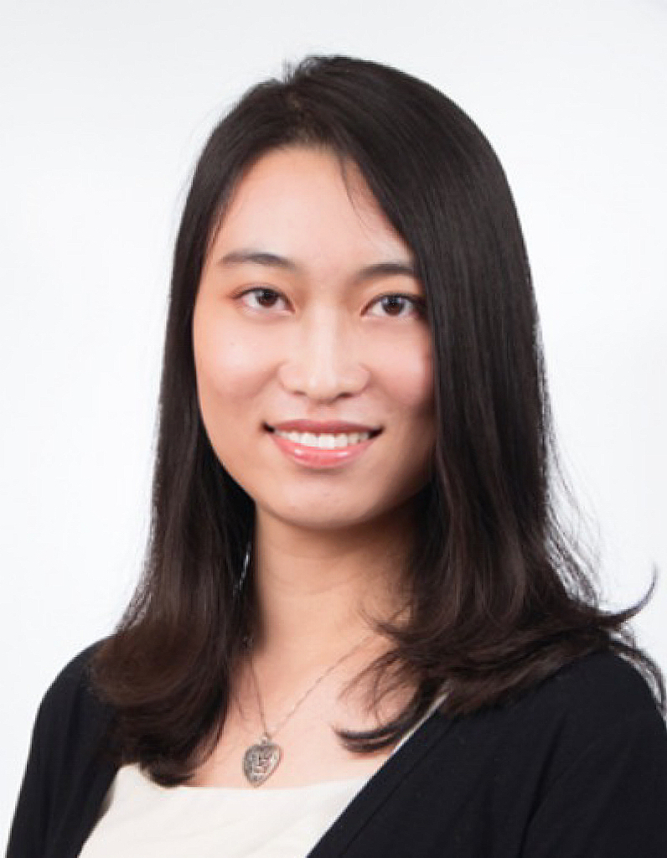
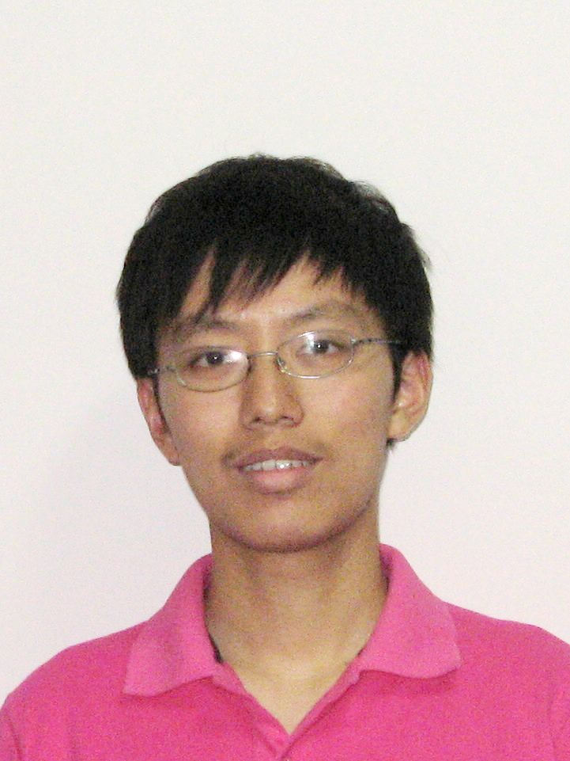
Thomas C. Chalmers Student Scholarship Finalists
Xuetao Lu
The University of Texas
MD Anderson Cancer Center
Sidi Wang
University of Michigan
Chao Yang
The University of Texas
MD Anderson Cancer Center

Slide 33
Thomas C. Chalmers Student Scholarship Recipient
Sidi Wang
University of Michigan

Slide 34
SCT Logo Slide

Slide 35
Sylvan Green Award

Slide 36
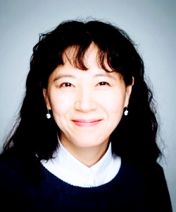
Sylvan Green Award Recipient
Su Jin Kang
Imperial College London

Slide 37
SCT Logo Slide

Slide 38
ED&I Early-Career Awards

Slide 39
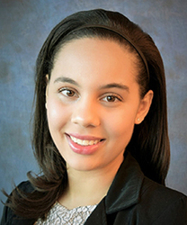
ED&I Early-Career Award Recipient
Patrice M. Hicks, PhD, MPH

Slide 40
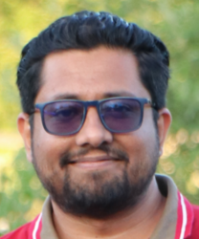
ED&I Early-Career Award Recipient
Noor Muhammad Khan
PhD Student

Slide 41
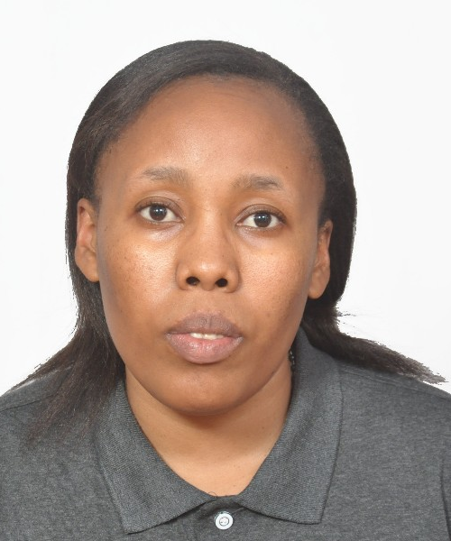
ED&I Early-Career Award Recipient
Willyhelmina Olomi, BSc, MSc PhD Candidate

Slide 42
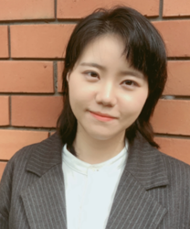
ED&I Early-Career Award Recipient
Charis Xuan Xie, MSc

Slide 43
SCT Logo Slide

Slide 44
Best Poster Presentation
Awards

Slide 45
SCT Logo Slide

Slide 46
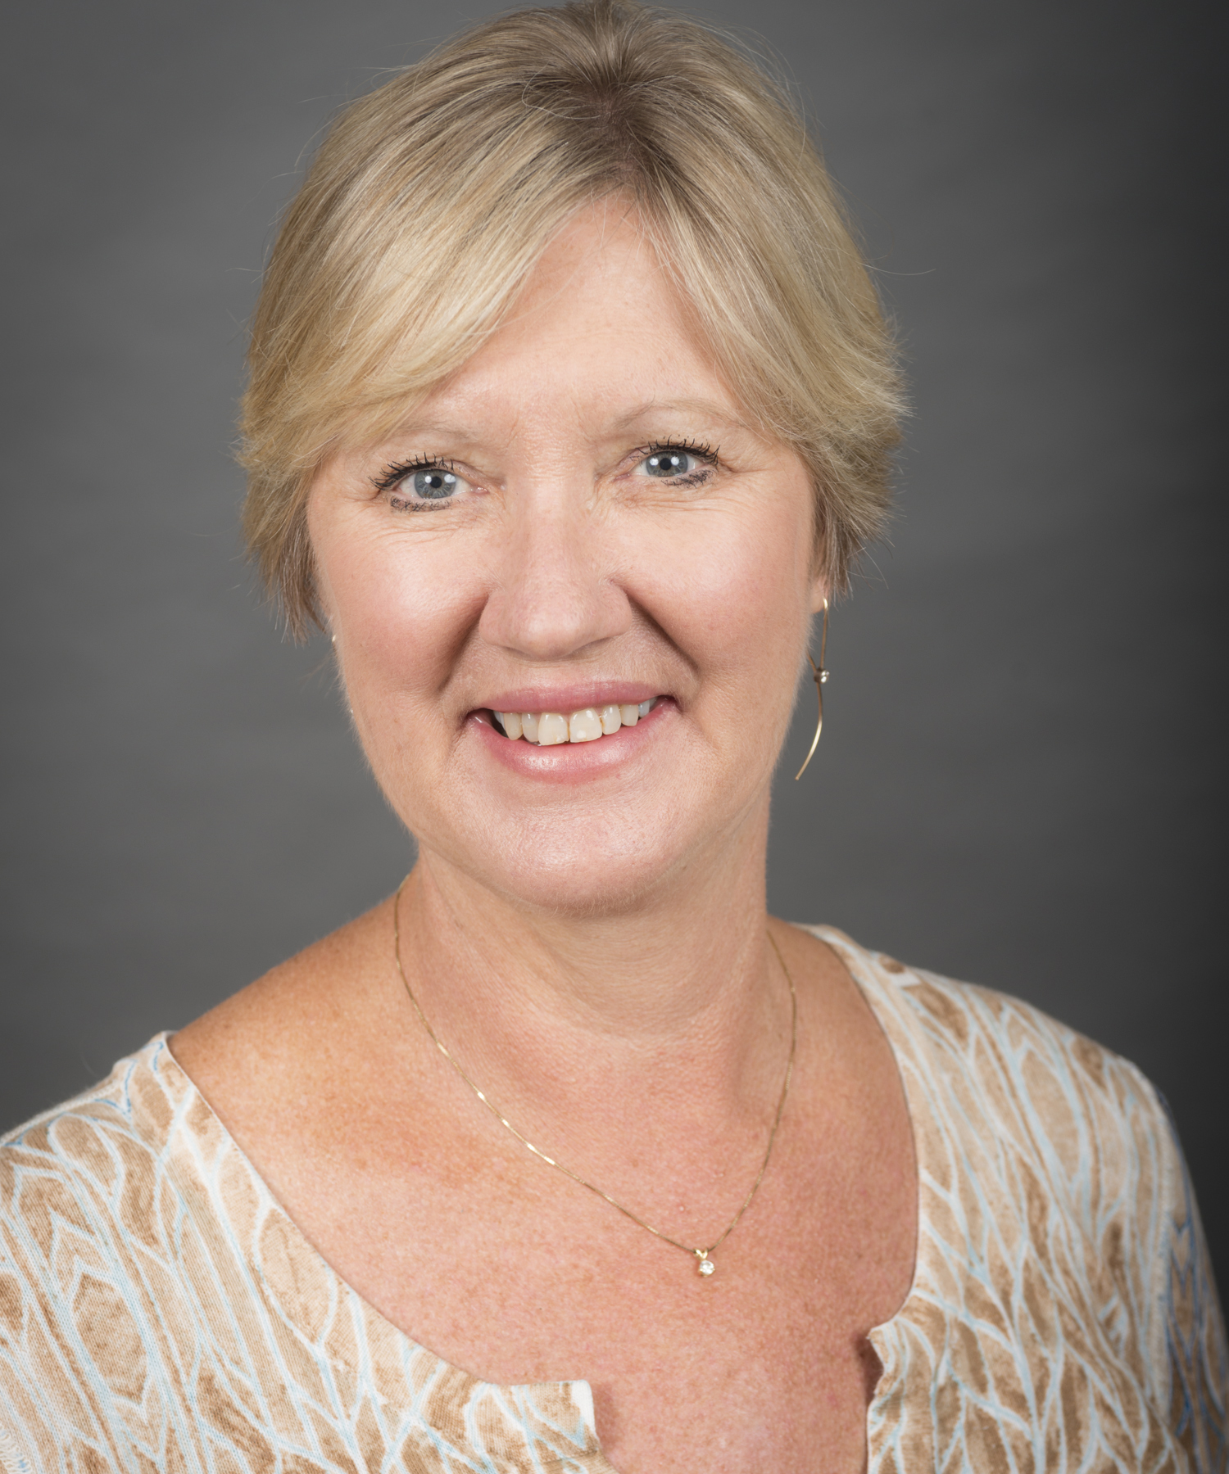
SCT President
2023 - 2024
Dixie Ecklund

Slide 47
Recognition of Outgoing Board Members
Li Chen, Treasurer
Alexia Iasonos, Director
Robert Lindblad, Director

Slide 48
SCT President
2022 - 2023
Lehana Thabane

Slide 49


